Slide 1

Data for AI Essentials
Chapter 1 – Select data AI technique
Notes:
Welcome to the Intel AI4Y program. My name is XXX and I am your facilitator of this program.

Slide 2
Learning Progression
Basic Data Science for AI
Introduction to Basic Statistics
Data Visualization
K – Nearest Neighbour
Evaluation methods
Data Import and Processing
Obtaining Data
Basic Data Processing and Visualization
Handling Erroneous and Missing Data
Data Machine Learning Techniques
Supervised Learning Techniques
Supervised Regression
Artificial Neural Networks
AI for Data Walkthrough
Model Outputs
Output Visualization and Validation
Housing Price Detection Project

Slide 3
Introduction to Basic Statistics
Notes:
I’m sure all of you have learned python by now. Before we dive into AI for data, we need to know basic statistics. Why? This is so that we get an informative view of data.

Slide 4
The 3M’s: Mean, Median, Mode
Mean
Median
Mode
The average value
The 50th percentile value
The most frequent value
Sum up all the data points divided by the number of data points
Useful if
distribution is skewed
Identify most
frequent occurence
Notes:
Do you know the 3Ms: Mean, Median and Mode?
Mean is the sum of all the data points divided by the number of data points.
Median is the 50th percentile value and is useful if the distribution is skewed.
Mode is the most frequent value and it can help us identify the most frequent occurence.

Slide 5
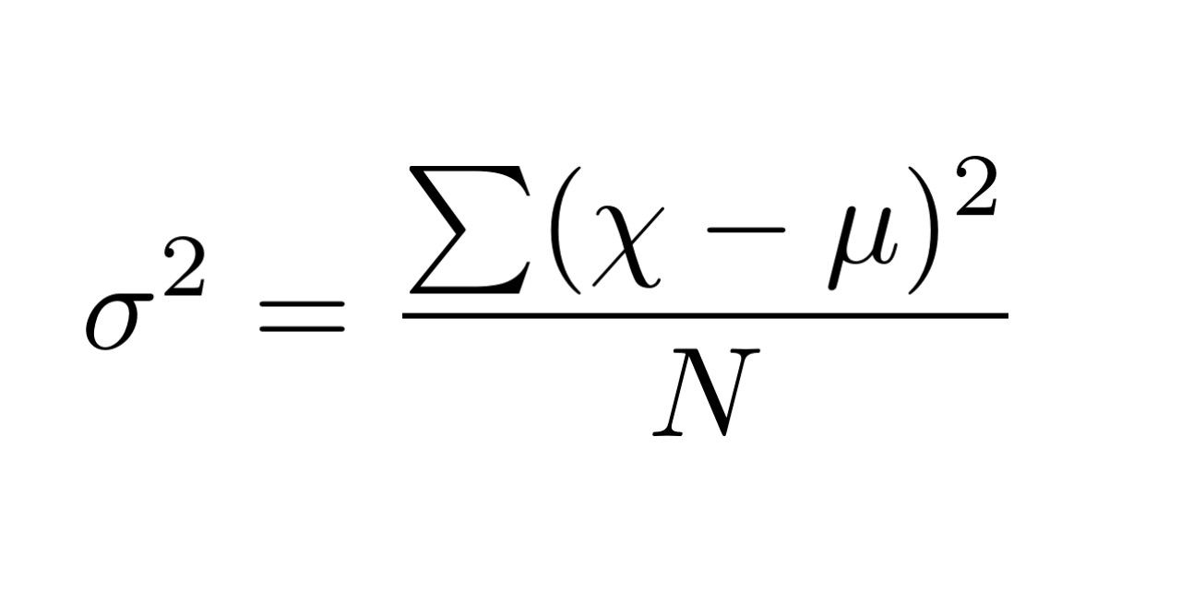
Standard Deviation & Variance
Standard Deviation
Variance
measure of how spread out the numbers are
average of the squared differences from the mean
have a "standard" way of knowing what is normal, square root of variance
Notes:
Next we have standard deviation and variance.
Standard deviation is a measure of how spread out the numbers are and gives a standard way of knowing what is normal.
Standard deviation is the square root of variance.
Variance is the average of the squared differences from the mean.

Slide 6
Setting up Jupyter Notebook
Notes:
Now that we’ve learned some basic statistics it’s time we do a little practice using what we’ve learned. Let’s set up Jupyter.
[Go to instructions to setup jupyter]

Slide 7
Statistics with Python
[Jupyter Notebook – Chapter 1 - Introduction to python with basic statistics.ipynb
Notes:
Now we will do some python recap with the basic statistics (mean, median, mode) we learned about. [Go to IPython Notebook]

Slide 8
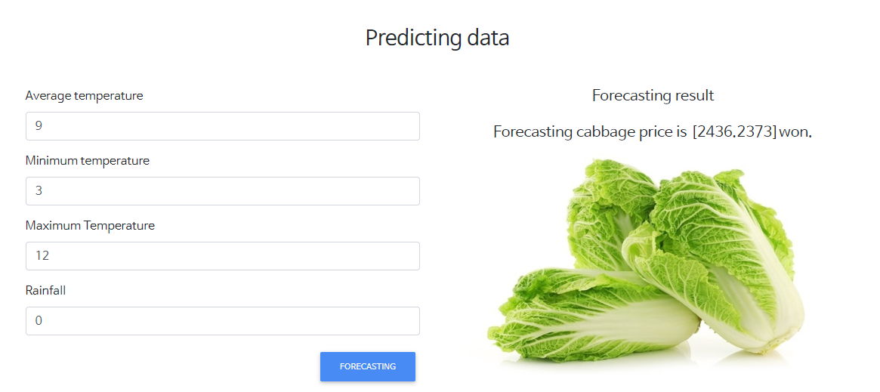
In data domain, we use computers to give us insights using our numerical data.
Source:vegita
Notes:
In data domain, we use computers to give us insights using our numerical data.

Slide 9
What are some applications of AI in data domain you can think of?
Notes:
What are some applications of AI in data domain you can think of?

Slide 10
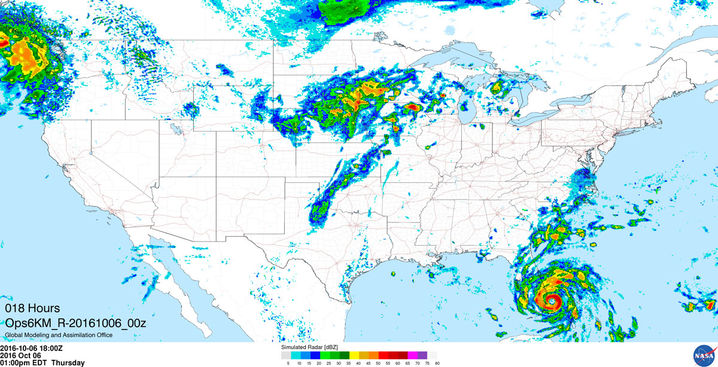

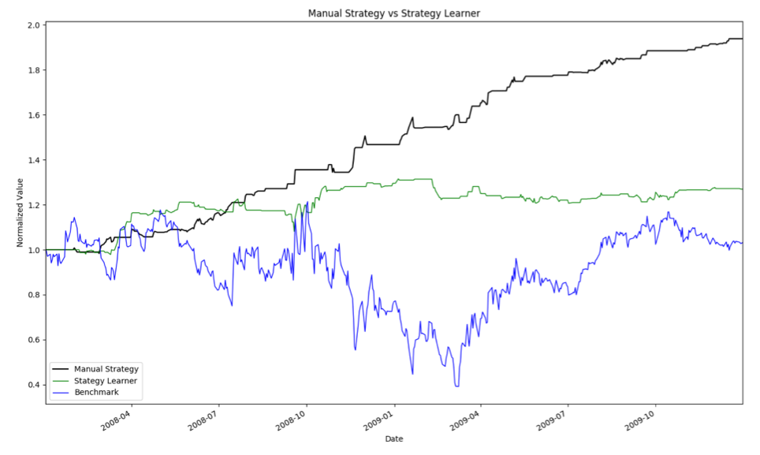
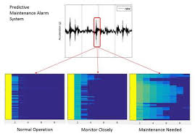
https://youtu.be/ImwXpbI5Ino
https://youtu.be/FloMHMOU5Bs
Weather forecasting
Source:nas.nasa.gov
https://youtu.be/G3WG9kxbFOY
Trading
Predictive Maintenance
Source: patrickchwalek.com
Source:matlabexpo.com
https://youtu.be/rNMsOoNERHE
Notes:
Possible applications:
Price prediction
Machine maintenance alert
Weather prediction
Medical diagnosis
Trading
Classification e.g. for health, loan
https://data-flair.training/blogs/machine-learning-applications/
See more in kaggle! https://www.kaggle.com/competitions

Slide 11
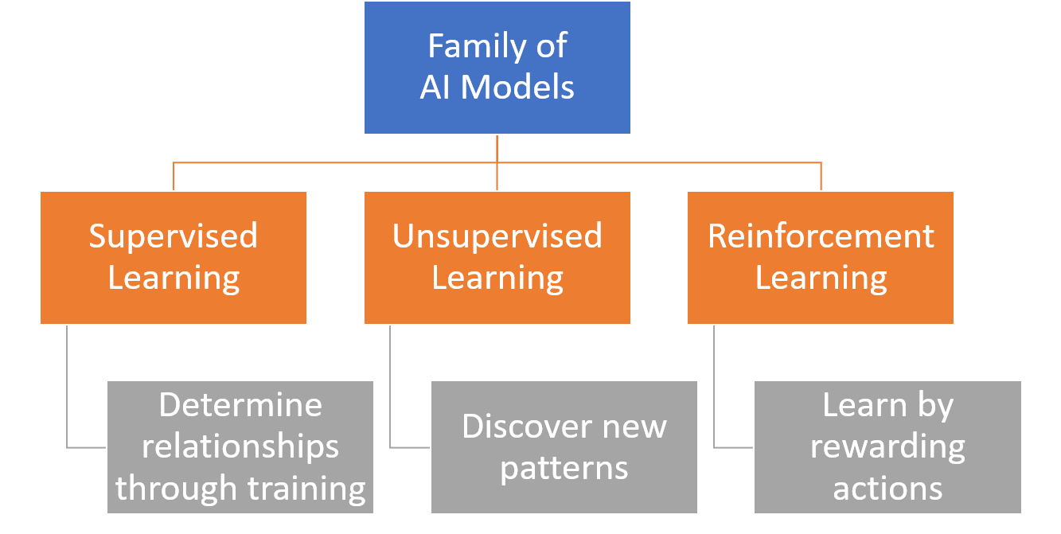
Notes:
Remember that Machine Learning techniques can be split into Supervised, Unsupervised and Reinforced Learning. This diagram in particular shows the types of applications that each algorithm can be used for. But for AI4Y, we are focusing on supervised and unsupervised learning.

Slide 12
AI Project Cycle
Copyright © 2019 Intel Corporation. All rights reserved. Intel and the Intel logo are trademarks of Intel Corporation in the U.S. and/or other countries. *Other names and brands may be claimed as the property of others.
Notes:
Do you remember the AI project cycle?

Slide 13
AI Project Cycle
Problem Scoping
Data Exploration
Evaluation
Data Acquisition
Modeling
Deployment
Copyright © 2019 Intel Corporation. All rights reserved. Intel and the Intel logo are trademarks of Intel Corporation in the U.S. and/or other countries. *Other names and brands may be claimed as the property of others.
Notes:
Remember that we used the cabbage price example for Acquire fundamentals? Do you remember how the problem was scoped and how the data was acquired and explored?
We also went to use the sketchy graphs to draw various graphs!
Let’s dive into data visualization and practice generating the graphs on python.

Slide 14
Data Visualization
Copyright © 2019 Intel Corporation. All rights reserved. Intel and the Intel logo are trademarks of Intel Corporation in the U.S. and/or other countries. *Other names and brands may be claimed as the property of others.
Notes:
Let’s dive into data visualization and practice generating the graphs on python.

Slide 15
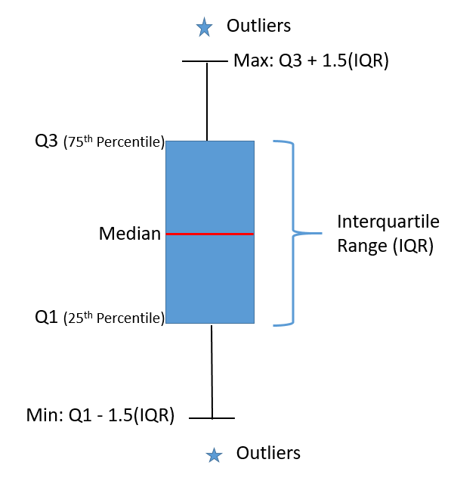
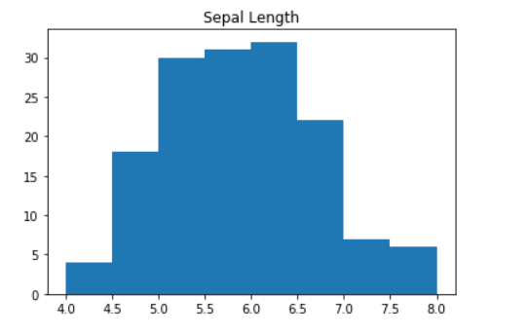
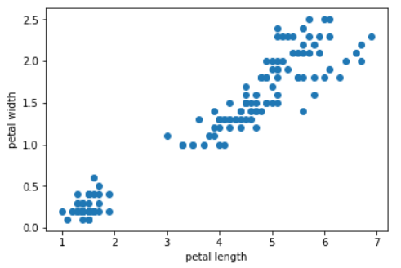
How Do We Identify Outliers Or Errors?
Utilise simple visualization tools (Matplotlib library)
Box plots: Visualize percentile values and interquartile range
Histograms: Understand the distribution based on bin sizes
Scatterplots: Identify data points that are far apart from each other
Notes:
Data visualization is important for us to be able to identify outliers or errors.

Slide 16
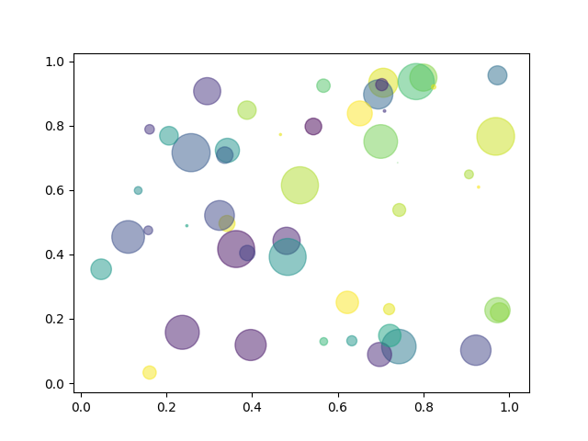
Scatter Plot
Notes:
Example of how a scatter plot looks like

Slide 17
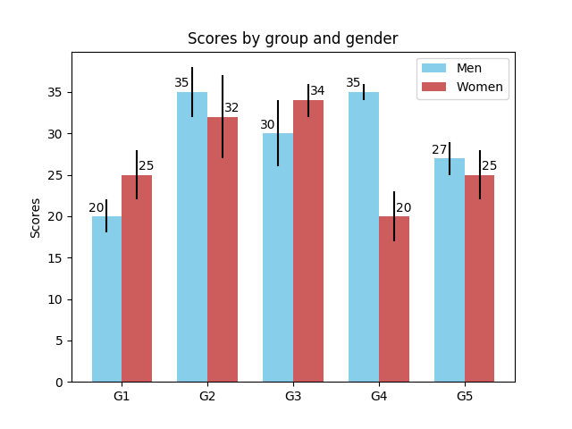
Bar Chart
Notes:
Example of how a bar chart looks like

Slide 18
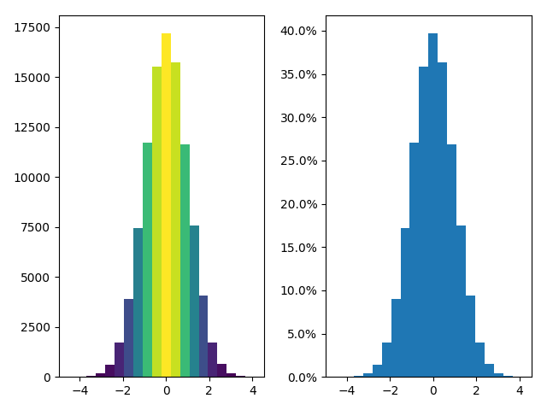
Histogram
Notes:
Example of how a histogram looks like

Slide 19
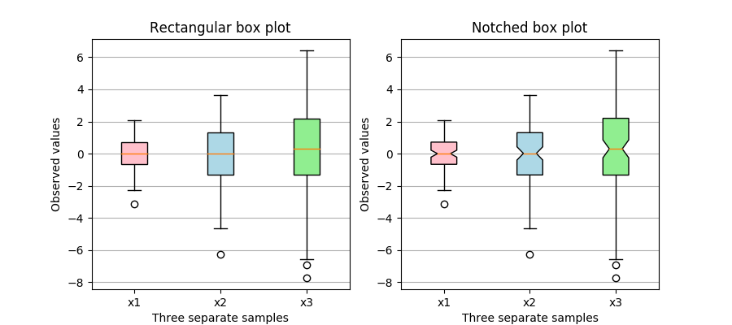
Box Plot
Notes:
Example of how a box plot looks like
Let go to jupyter notebook to practice plotting some graphs.

Slide 20
Hands-on
[Jupyter Notebook – Chapter 1 - Data visualization.ipynb
Notes:
Time to have some hands-on!

Slide 21
AI Project Cycle
Problem Scoping
Data Exploration
Evaluation
Data Acquisition
Modeling
Deployment
Notes:
Next, let’s go to modeling to learn more about the different types of algorithms.

Slide 22
Notes:
Machine Learning techniques can be split into Supervised, Unsupervised and Reinforced Learning. This diagram in particular shows the types of applications that each algorithm can be used for. But for today’s class we are going to focus on supervised and unsupervised learning.

Slide 23
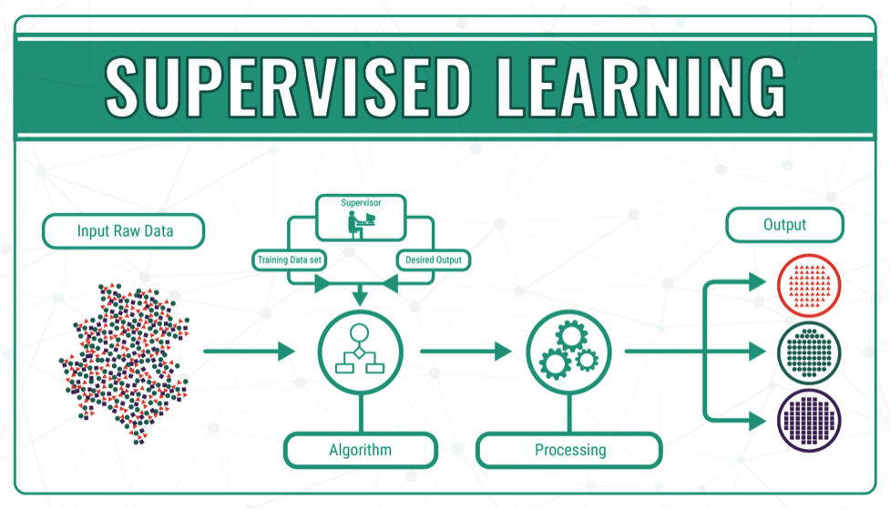
Source:https://bigdata-madesimple.com/machine-learning-explained-understanding-supervised-unsupervised-and-reinforcement-learning/
Notes:
Do you remember what is supervised learning? [Students response]

Slide 24
Supervised Learning
Goal: To find specific relationships or structure in the input data that allow us to effectively produce correct output data
Data is labelled
Algorithms predict the output from the input data
Classification (map input to output labels)
Regression (map input to a continuous output)
Notes:
The goal of supervised learning is to find specific relationships or structure in the input data that allow us to effectively produce correct output data. For supervised learning, data must be labelled. The algorithms in supervised learning predict the output from the input data, we can split them into two types, one is classification where it maps input data to output labels and the other is regression where it maps input data to a continuous output.

Slide 25
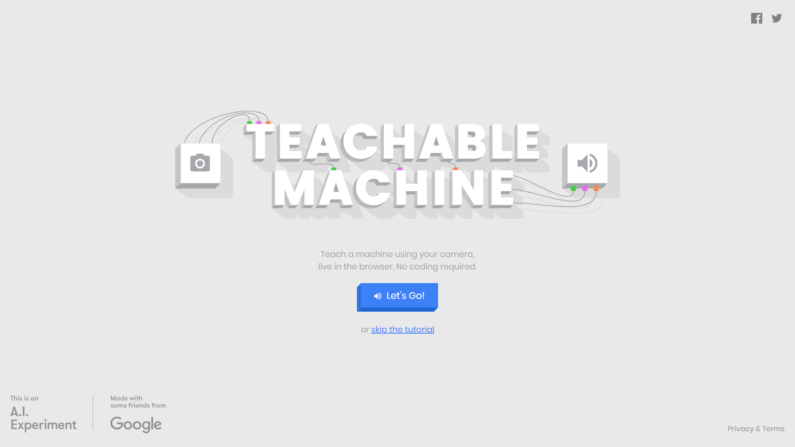
https://teachablemachine.withgoogle.com/
Notes:
Try this webapp to understand more!

Slide 26
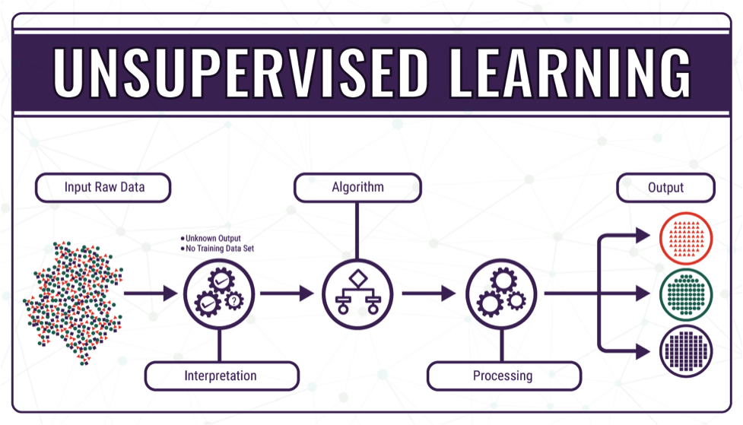
Source:https://bigdata-madesimple.com/machine-learning-explained-understanding-supervised-unsupervised-and-reinforcement-learning/
Notes:
Do you remember what is unsupervised learning? [Students response]

Slide 27
Unsupervised Learning
Goal: To learn the inherent structure of our data without using explicitly-provided labels
Data is unlabelled
Algorithms learn the inherent structure from the input data
Clustering (learn relationships between individual feature)
Dimensionality Reduction (methods used to represent data using less columns or features)
Notes:
Unsupervised learning is very useful in exploratory analysis because it can automatically identify structure in data. For example, if an analyst were trying to segment consumers, unsupervised clustering methods would be a great starting point for their analysis. In situations where it is either impossible or impractical for a human to propose trends in the data, unsupervised learning can provide initial insights that can then be used to test individual hypotheses.
In unsupervised learning, the data is unlabelled. We can group the algorithms in unsupervised learning to clustering and dimensionality reduction. Clustering algorithms learn relationship between individual features and dimensionality reduction algorithms are used to represent data using less columns or features.

Slide 28
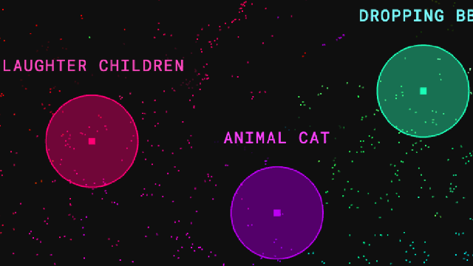
The infinite drum machine
https://experiments.withgoogle.com/ai/drum-machine/view/
Notes:
Let’s see unsupervised learning in action!
https://experiments.withgoogle.com/ai/drum-machine/view/

Slide 29
Personality prediction
Notes:
Now, let us play a game. We want to predict each others’ personality and learn about classification algorithm through this activity.

Slide 30
Instructions
Make a cross where you think your personality fits in this graph.
Write your name next to the cross
People Focused
Active
Passive
Task Focused
Notes:
All youths will rate themselves where they think they fall in the graph, by placing their name next to the cross.
Note: Be careful not to paint the 4 extreme points of the axis in negative light as this will create bias in the youths mind and increase inaccuracy.
Use this for reference: https://www.axiomsoftware.com/disc/personality-types.php

Slide 31
Instructions
Individually complete the personality quiz at https://tinyurl.com/discanimal
Note down the Animal that you best represented.
KEEP YOUR RESULTS SECRET
Notes:
Now, you will individually complete the personality quiz.
Note down the animal that you best represented.
Keep your result secret!

Slide 32
Instructions
If you have been assigned as a:
Lion, change your mark to ⇑
Otter, change your mark to ⚫
Golden Retriever, change your mark to ⃞
Beaver, change your mark to ⃤
Notes:
If you have been assigned as a:
- Lion, change your mark to ⇑
- Otter, change your mark to ⚫
- Golden Retriever, change your mark to ⃞
- Beaver, change your mark to ⃤

Slide 33
Instructions
You will notice that I have asked some students not to change their mark.
We will instead predict what their personality test score was using the nearest neighbour algorithm.
Based on the nearest neighbour, what do you think their personality test score was?
Notes:
- You will notice that I have asked some students not to change their mark.
- We will instead predict what their personality test score was using the nearest neighbour algorithm.
- Based on the nearest neighbour, what do you think their personality test score was?

Slide 34
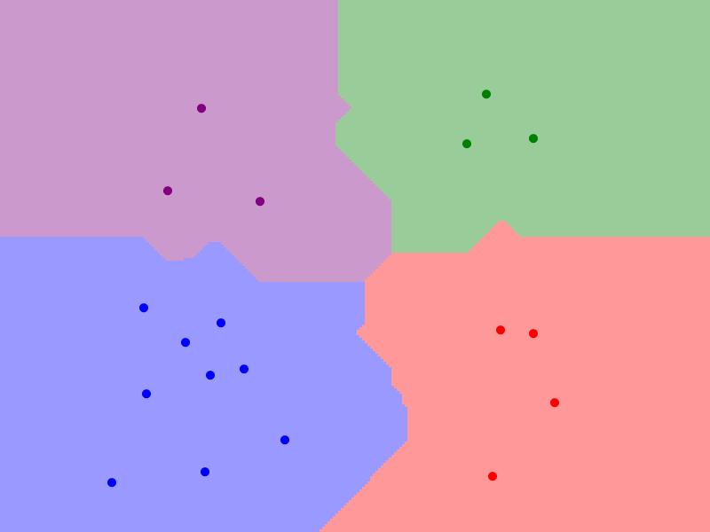
Visualizing a Nearest Neighbour Algorithm
❌
http://vision.stanford.edu/teaching/cs231n-demos/knn/
Notes:
Now we will go to http://vision.stanford.edu/teaching/cs231n-demos/knn/
Discussion:
White area: undefined. Need more data
Why go through multiple k?
Great! We have seen how the k-nearest neighbour works.

Slide 35
K – Nearest Neighbour
Notes:
What you’ve just done in the activity is similar to the nearest neighbour algorithm. But today we will look deeper into the K-nearest neighbour algorithm.

Slide 36
K-Nearest Neighbour (KNN)
KNN can be used in classification or regression problems
Relies on the surrounding points or neighbours to determine its class or group
Utilises the properties of the majority of the nearest points to decide how to classify unknown points
Based on the concept that similar data points should be close to each other
Copyright © 2019 Intel Corporation. All rights reserved. Intel and the Intel logo are trademarks of Intel Corporation in the U.S. and/or other countries. *Other names and brands may be claimed as the property of others.
Notes:
K-Nearest Neighbour we will called it KNN can be used in classification or regression problems. It relies on the surrounding points or neighbours to determine its class or group. It utilises the properties of the majority of the nearest points to decide how to classify unknown points. It is based on the concept that similar data points should be close to each other.

Slide 37
Example: Predict fruit sweetness
Sweet
Not Sweet
X
X
X
1 - Nearest Neighbour
2 - Nearest Neighbour
3 - Nearest Neighbour
Copyright © 2019 Intel Corporation. All rights reserved. Intel and the Intel logo are trademarks of Intel Corporation in the U.S. and/or other countries. *Other names and brands may be claimed as the property of others.
Notes:
For example i want to predict fruit sweetness of fruit X given the plant height, I have some data where green represents a fruit that is sweet and blue represents a fruit that is not sweet. With k nearest neighbour, if k=1, it will form a circle that fits one data point closest to X as shown in the graph, thus predicting that the fruit is not sweet. If k=2, you can see that there is 1 vote for sweet and 1 for not sweet. If k=3, you see that there are 2 green and 1 blue data point thus predicting that the fruit X is sweet.

Slide 38
Let’s Kahoot!
Trainer Link:
https://play.kahoot.it/#/?quizId=c5c567c3-76da-43dd-9532-4e211f029108&token=f2a04012-2eb4-4378-af2e-ef30b9b8d50e&user=febriy
Notes:
Let’s do a quiz to test our understanding of what we’ve learnt so far.

Slide 39
AI Project Cycle
Problem Scoping
Data Exploration
Evaluate
Data Acquisition
Modeling
Deployment
Notes:
Next, let’s go to evaluate to learn more about the different evaluation methods.

Slide 40
Evaluation methods
Notes:
We’ve touch on the k-nearest neighbour as one way we can do classification. We also have noticed that not all the prediction given through the knn are accurate.
How do we measure the performance of our model?

Slide 41
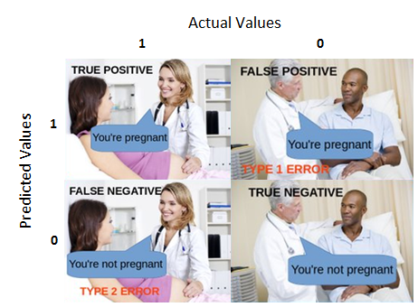
Confusion Matrix
Reality to Prediction: Ture of False
Predict Positive and Reality to Prediction is True
Predict Positive but Reality to Prediction is False
Positive
Negative
Predict Negative and Reality to Prediction is True
Predict Negative but Reality to Prediction is False
Adapted from https://towardsdatascience.com/understanding-confusion-matrix-a9ad42dcfd62

Slide 42
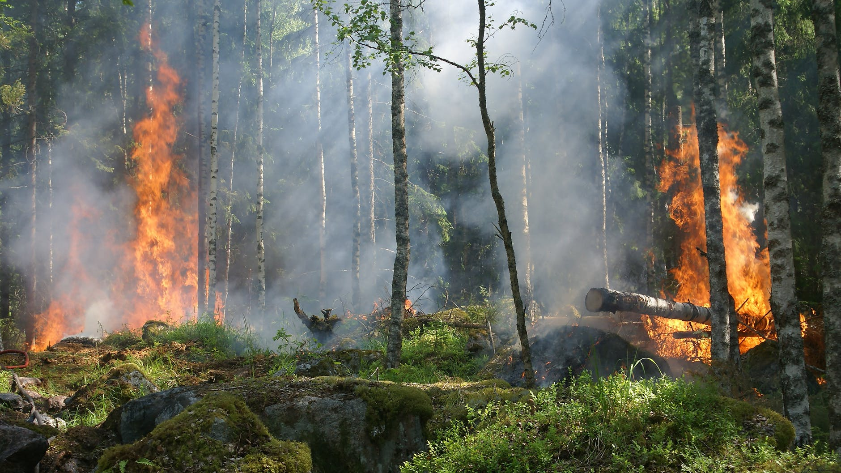
Is there forest fire?
Reality to Predication:
True or False
Prediction:
Positive or Negative
Notes:
Firstly, we will go through several terms which are very important to the evaluation process.
In this example, suppose we are predicting forest fire based on weather data.
There’s 2 possible results that the prediction algorithm might give us: Predict that there’s a fire, or predict that there’s no fire.

Slide 43
Is there forest fire?
Reality to Prediction: True
Prediction: Positive
True Positive
Notes:
True Positives (TP): Predicted yes (detector says that there is a fire), and in actual fact is yes (there is a fire).
This is a good result. Forest firefighter will be called and they will fight the fire.

Slide 44

Is there forest fire?
Reality to Prediction: True
Prediction: Negative
True Negative
Notes:
True Negatives (TN): Predicted no (detector says that there is no fire), and in actual fact is no (there is no fire).
This is good, no fire is happening and everyone can relax.

Slide 45
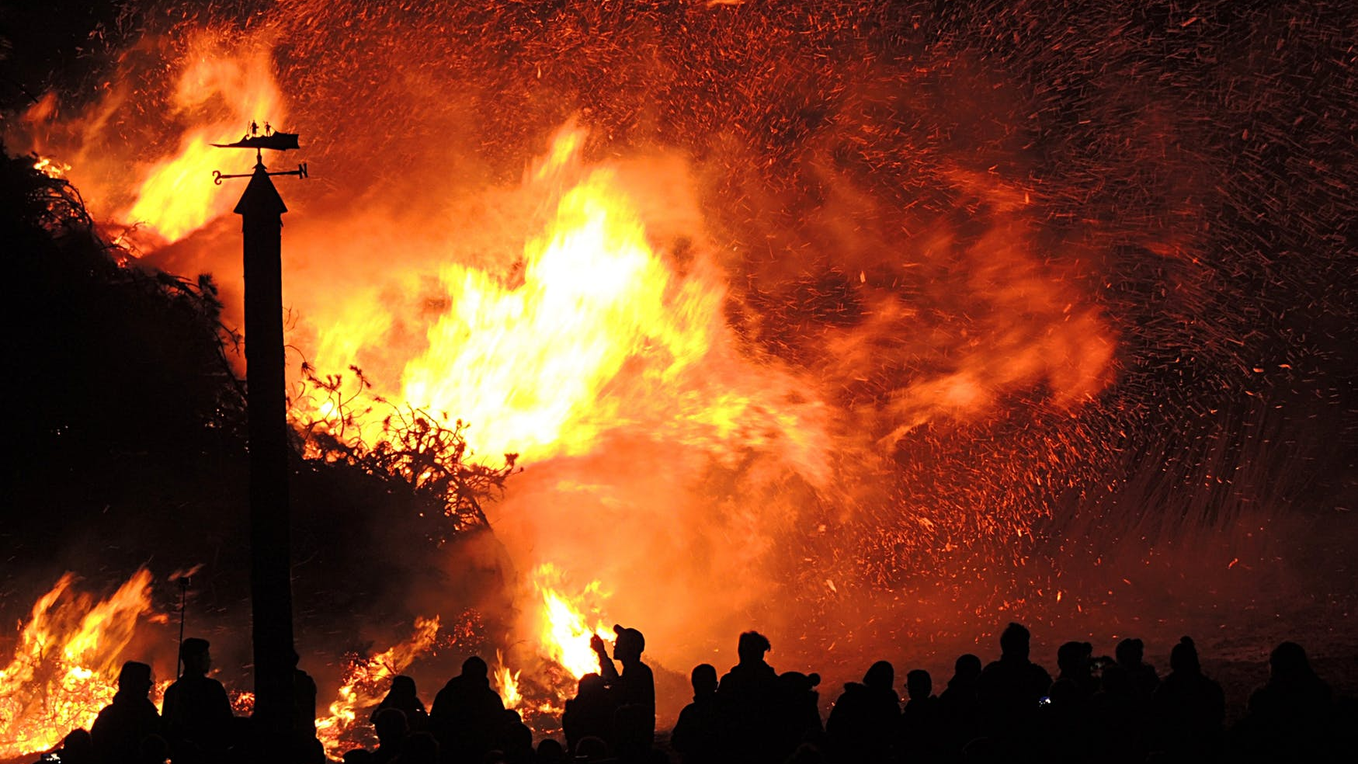
Is there forest fire?
Reality to Predication: False
Prediction: Negative
False Negative
Notes:
False Negatives (FN): Predicted no (detector says that there is no fire), but in actual fact is yes (there is a fire).
This result is very dangerous! Imagine realising the fire only when it is too late!

Slide 46
Is there forest fire?
Reality to Prediction: False
Prediction: Positive
False Positive
Notes:
False Positives (FP): Predicted yes (detector says that there is a fire), but in actual fact is no (there is no fire).
This too is an inaccurate result. Firefighter will be dispatched only to find that there is no fire.
However, this is not as dangerous as the false negative case, as shown previously.

Slide 47
Confusion Matrix
 |  | Reality to Prediction
 |  | True or False
Predicted | Positive | True Positive (TP) | False Positive (FP)
 | Negative | False Negative (FN) | True Negative (TN)
Notes:
The result of comparison between the prediction and reality can be recorded in what we call the confusion matrix
A confusion matrix allows us to understand the prediction results. It is not an evaluation metric.
True Positives (TP): Predicted yes (detector says that there is a fire), and in actual fact is yes (there is a fire).
True Negatives (TN): Predicted no (detector says that there is no fire), and in actual fact is no (there is no fire).
False Positives (FP): Predicted yes (detector says that there is a fire), but in actual fact is no (there is no fire).
False Negatives (FN): Predicted no (detector says that there is no fire), but in actual fact is yes (there is a fire).

Slide 48
Accuracy
Accuracy is the percentage of correct prediction out of all the observations
Accuracy = (TP + TN) / (TP + FP + TN + FN)
Accuracy = (Correct Prediction) / (All Cases)
Is high accuracy equivalent to good performance?
Notes:
Accuracy is the percentage of correct prediction out of all the observations.
This means, given a number of predictions and observations, what is the percentage of the predictions that is TRUE?
Look at the formula carefully. The numerator is made up of all the prediction that is true. The denominator is made up of the sum of all predictions.
Do you think high accuracy is equivalent to good performance of a model?
What do you think is a reasonable percentage of a model with good performance?
[Student’s response]

Slide 49
Is there forest fire?
Reality: 2 % Probability
Prediction: Always Yes
98% accurate
But it is usable?
Notes:
A high accuracy score does not mean that the model is a good one.
Imagine that in reality, there’s a 2 percent probability that there is a forest fire in a year.
We can create a model that always predict that there is NO fire.
It will be 98% correct, but will it be usable? Probably not!
Maybe it is more useful to calculate the percentage of cases that are predicted as positive that are actually positive.

Slide 50
Precision
Precision is the percentage of cases that are predicted as positive (TP+FP) that are actually positive (TP)
Precision = (TP) / (TP + FP)
Precision = (True Positive) / (Total Predicted Positive)
Notes:
Precision is the percentage of cases that are predicted as positive that are actually positive.
Imagine: Every time our model predicts that there will be fire (positive), the firefighter will check for the fire.
It might turn out that there’s fire OR there is no fire.
What is a common term for FP? When there’s a fire alarm while there’s no fire?
[Student’s response]
Yes, this is called false alarm.
Precision is important.
Imagine if there’s low precision. What will happen? The firefighter may get complacent. There’s too many false alarm!
Remember the ‘boy who cry wolves?’

Slide 51
Recall
Recall measures the fraction of positive cases (TP+FN) that are correctly identified (TP)
Recall = (TP) / (TP + FN)
Recall = (True Positive) / (Total actual positive)
In the case of forest fire, which one will you favour? False Negative or False Positive?
Notes:
Recall measures the fraction of positive cases that are correctly identified
In other words, how many times does the machine predicts there’s a fire when there’s indeed a fire?
We want to get this as high as possible. Remember the False negative?
This is the case when the machine predicts that there is no fire, when there’s fire!
FN and FP, which one will you favour?

Slide 52
Which metric is important?
Cases with high FN cost
Cases with high FP cost
Forest fire
Viral outbreak
Spam
Mining
Which one is more important? Recall or Precision?
Notes:
Which metric is important?
It really depends on the cases.
In the case of Forest fire, a false negative has very high cost.
Imagine there’s no alert even though there’s a fire. The whole forest will be gone!
What are some cases when a false negative has high cost?
Forest fire: Forest fire is not attended to
Viral outbreak: Virus spread without intervention
What are some cases when a false positive has high cost?
Spam: email holder will miss important information
Mining: Wasted money on exploration and digging, without any precious metal/ coal underneath the land

Slide 53
Both measures are important
High Precision,
Low Recall
High Recall,
Low Precision
Precision = (TP) / (TP + FP)
Recall = (TP) / (TP + FN)
We need something that account for the 2 metrics
Notes:
If you want to know if your predictions are good, you need these two measures: Recall and Precision.
You can have a high precision and a low recall.
You can have a precision of 1 (so when you say it's positive, it's actually positive) but still have a very low recall (you predicted 3 true positives but did not account for the 15 other positives).
Or you can have a high recall and low precision.
You can have a recall of 1 (you correctly predict all positive cases) but still have a very low precision (you also made a lot of false alarm).
Precision = (TP) / (TP + FP)
Recall = (TP) / (TP + FN)

Slide 54
F1 - Score
Used to seek a balance between precision and recall
F1 score = 2 x (Precision x Recall)
(Precision+Recall)
1 is the maximum F1 value
Notes:
In the previous slide, we mention about the importance of balance between recall or precision.
The F1 score is a measure of balance between precision and recall.
Look at the formula. Imagine the perfect scenario when we have the value of 1(100%) for both precision and recall.
What F1 value do you get?
You get 1
1 is the perfect F1 value.
Now, imagine low score for both precision. Say, 0.1.
What F1 value do you get?
You get 0.1
What happen when you get very high precision and low recall?
What happen when you get very low precision and high recall?
What happen when you get high precision and high recall?

Slide 55
Let’s practice
Notes:
Let’s do some practice questions.

Slide 56
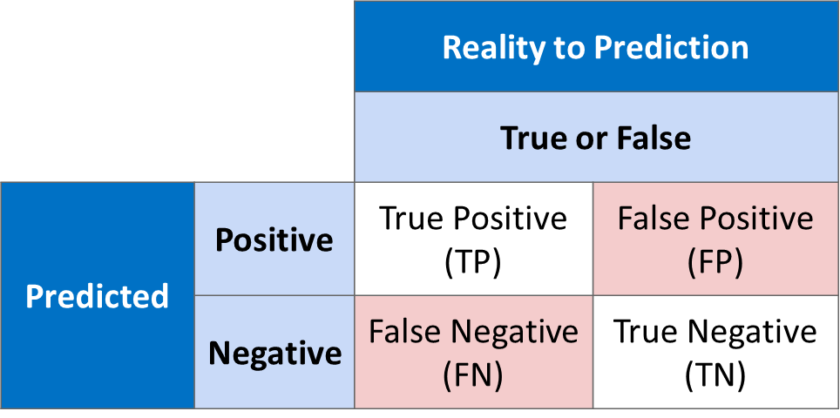
Example 1
Calculate the following:
Accuracy
Precision
Recall
F1-score
 | Actual: 1 | Actual: 0
Predicted: 1 | 15 | 12
Predicted: 0 | 47 | 118
Normal example
Notes:
Normal example

Slide 57
Example 2
Calculate the following:
Accuracy
Precision
Recall
F1-score
 | Actual: 1 | Actual: 0
Predicted: 1 | 0 | 3
Predicted: 0 | 3 | 94
accuracy may not be the best metric
Notes:
Example where accuracy may not be the best metric

Slide 58
Example 3
Calculate the following:
Accuracy
Precision
Recall
F1-score
 | Actual: 1 | Actual: 0
Predicted: 1 | 5 | 0
Predicted: 0 | 45 | 50
Precision may not be the best metric
Notes:
Example where Precision may not be the best metric

Slide 59
Example 4
Calculate the following:
Accuracy
Precision
Recall
F1-score
 | Actual: 1 | Actual: 0
Predicted: 1 | 50 | 50
Predicted: 0 | 0 | 0
recall may not be the best metric
Notes:
Example where recall may not be the best metric

Slide 60

Notes:
Example where recall may not be the best metric

